Slide 1

HPI Course Overview Data Preparation for Science
Felix Grzelka Margaux Gatrio

Slide 2
Agenda
Description
Our task
Our dataset
Problems
Problems we faced when preparing the data for our task
Method
Data preparation tool
Scripting (libraries)
Manual editing
Concrete steps
Live Demo!

Slide 3
The Task
Look up HPI courses and their course related data based on different parameters (e.g. ECTS Points, teaching form, etc.)
Combine, visualize and integrate these into a “Database” and enable batch-downloading of course materials (e.g. Slides)

Slide 4
The Dataset
The Dataset is scraped from the HPI websites
It contains:
Course name
Teaching form
Enrolment deadline and type
Course language
Maximum participants
Weekly hours
ETCS and creditability
Grading
Course website of the chair
Pdf files linked on course site

Slide 5
Problems
Websites don't use ID-tags for most elements
so XPATH expressions needed to rely on heading text, etc.
No common format for websites of chairs
Different URLs lead to essentially the same website, but slightly adapted for each field of study
e.g. duplicate Websites for Data Prep for ITSE and DE
Inconsistencies for example in the field teaching form
e.g. 'SP', 'Seminar/Project', 'Project/Seminar’
Missing values
e.g. teaching language

Slide 6
Method
Data preparation tools:
Python to crawl the HPI websites
Combination of XPATH and Regex to extract useful information from different sites
Googles OpenRefine to improve data quality and clear up some inconsistencies

Slide 7
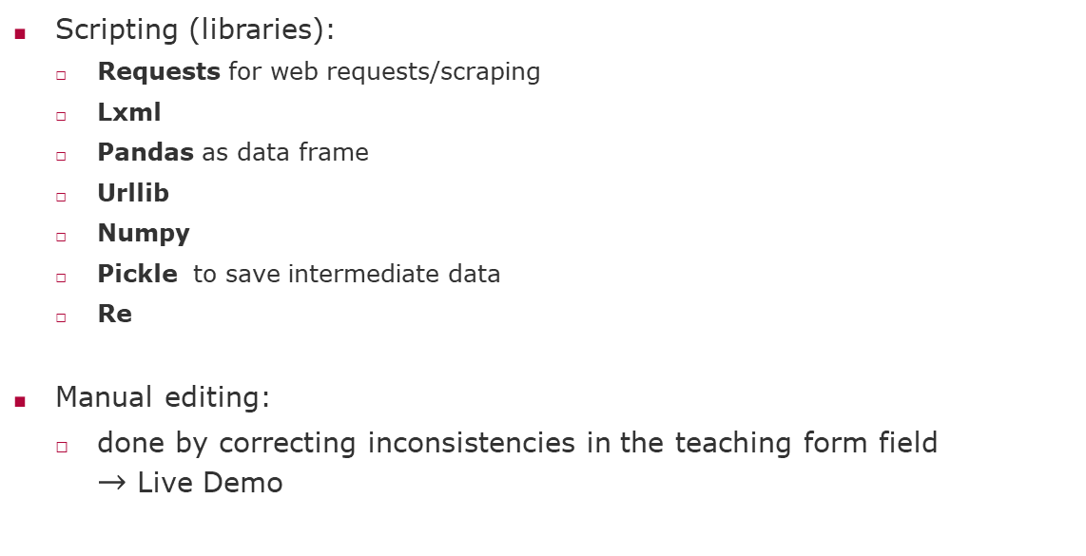
Method
Scripting (libraries):
Requests for web requests/scraping
Lxml
Pandas as data frame
Urllib
Numpy
Pickle to save intermediate data
Re
Manual editing:
done by correcting inconsistencies in the teaching form field $→$ Live Demo

Slide 8
Thank you for your attention!
Felix Grzelka
Margaux Gatrio

Slide 9
Concrete steps
Crawl the main HPI courses website to obtain a list of course lists (e.g. Bachelor, Master courses, etc.)
Crawl each table-page with courses and returns a dict with course name and URL to course page.
Combine the list of dicts to one big list, which only contains URLs.
Downloads the individual course websites.
Use XPATH to extract information from the course websites. Store it in a dict.
If course website links to a course site from the chair, download the chair site as well.
Finds all Links, on the websites that destination ends with the given file extension (e.g. '.pdf', '.pptx').
Create Pandas data frame.
Use pandas built in methods to remove duplicates and save the result as .csv file.
Import csv in OpenRefine.
Use OpenRefine to remove inconsistencies in some columns.

Slide 10
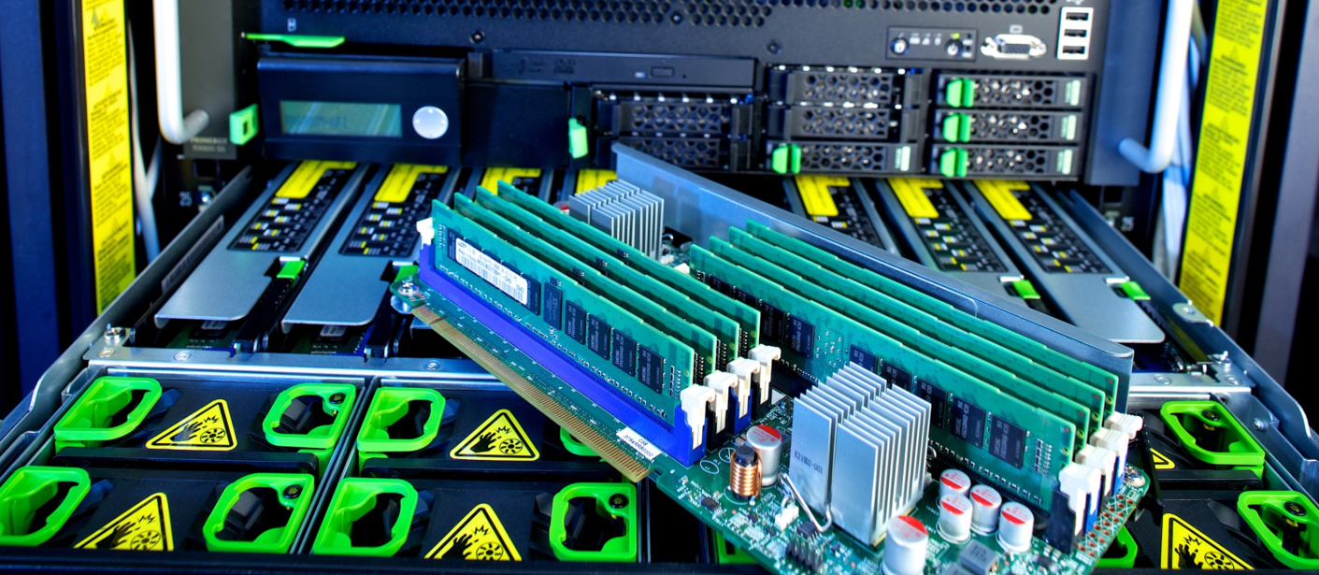

Slide 11


Slide 12
Presentation Title (Verdana 20pt) - maximum 2 lines

Slide 13
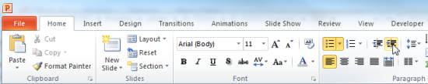
Explanations - Text layers
First text layer for running text.
Second level for bullet points
Third level for bullet points
Fourth level for bullet points
Fifth level for numberings
Sixth level for listings
Seventh text layer for Core Messages
In this template, we pre-formatted different text layers (as you can see on the right side). You don’t have to generate bullet points manually. By the way: Please avoid this!
To change from one text layer to the next, use the Increase / Decrease List Level buttons:

Slide 14
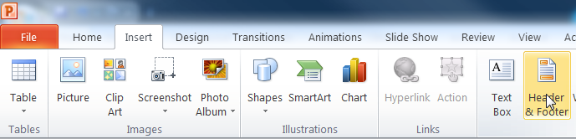
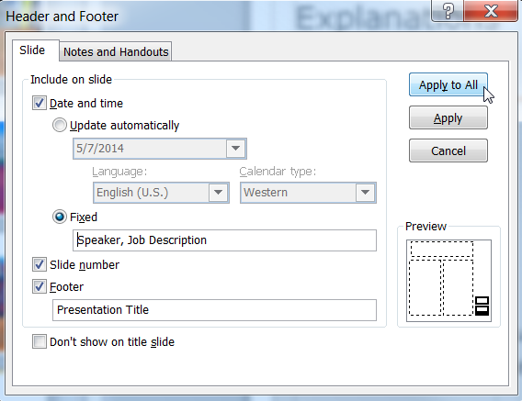
Explanations - Footer
You can insert or change your presentation‘s footer. Click on the Insert-tab | Header and Footer | After filling in your descriptions click on Apply to All.
Descriptions:
Activate date and time and write in:Speaker, Job Description
Activate the slide number.
Activate the footer and write in: Presentation Title
Don‘t use the template without the complete footer.

Slide 15
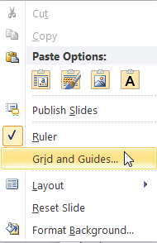
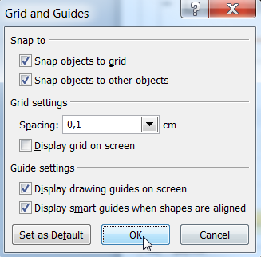
Explanations - Drawing guides
You can enable your guide-lines to align objects on the slide (View | Show | Select the option „Guides“)
Or hit the right mouse button outside the slide and go at „Grid and Guides…“

Slide 16
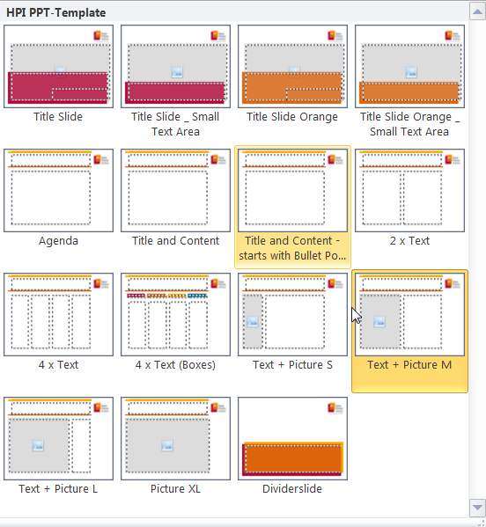
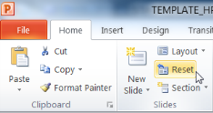
Explanations - Slide layouts
You can choose between different slide layouts. These pre-defined layouts gives you the oportunity to use text and visualisations just the right way.
To use these layouts:
Click on the Home-tab | New Slide or Layout | and choose one out of the layouts
Click „Reset“ to reset to the predefined slide layout.

